Slide 1
Deep Learning Project
AI Bot Mr.Steal for Fruit Classification
Team
Ann Chittilappilly
Piyu Tiwari
Sahithi Muddana
Harinishri Srikanth
Avancha Bhargava

Slide 2
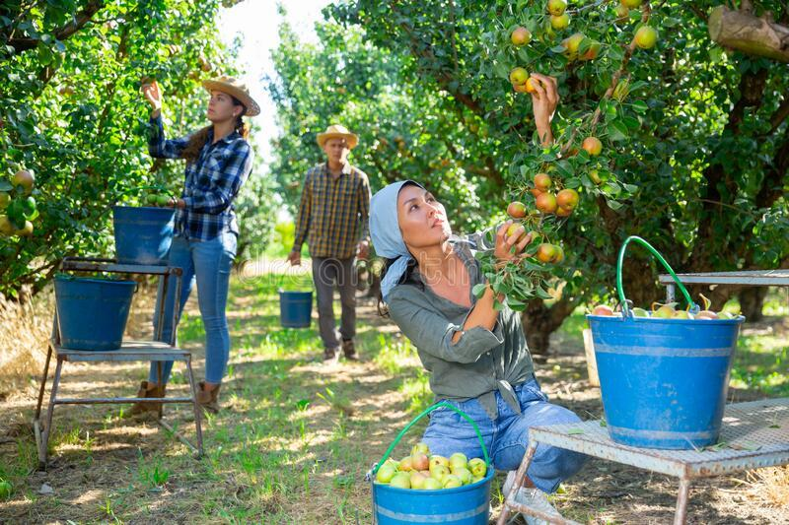
Introduction
California - top producer for pears
Fruit picking - manual and mundane
AI based fruit picking - Reduced cost, Time saving
Cheaper investment over long time
Reduces human exposure to hazardous situations
Workers shortage due to pandemic
Notes:
Fruit picking has been a laborious and hard task and has been manual and mundane in nature.
Apart from reducing costs AI based fruit picking has gained popularity as it also reduces human exposure to extreme heat, wildfire smokes, and also shortage of workers due to current global pandemic situations
California is one of the top producer for pears

Slide 3
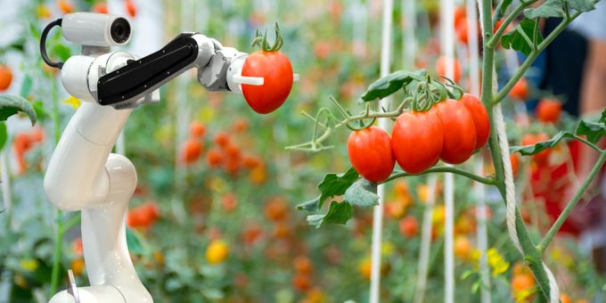
Use Case
Identify large firm and distributor that distribute pears across the country.
Pear farms can’t be diversified, has to be grown in single large areas.
Challenge for AI - green pears ,difficult to distinguish.
Developed a Neural network based solution to tackle this problem.
Notes:
We have identified large firm and distributor that distributed pears across the country. As pears require very low temperatures to bloom and bare fruits, the farms can’t be diversified and has to be grown in single large areas.
So picking these fruits at harvest season is a very heavy work and a challenge for AI as well as the canopy and the fruit are green in color and it is difficult for robot for identifying the pears just by color identification.
So we found this as an interesting use case to tackle this situation and developing a Neural Net algorithm that can classify the image more accurately reducing wastage and maximizing profits.

Slide 4
Dataset
2088 images as subset from a large dataset. The ratio of pear to not pear in dataset is 1:2
Train Test split - 60% for training, 20% for testing and 20% for validation
Class | No of Observations
Pear | 696
Not Pear (Other Fruits) | 1392
Dataset | No of Observations
Training | 1254
Testing | 417
Validation | 417

Slide 5
Logistic Regression
Using train data we have used logistic regression and have achieved a test accuracy of 97.96%.
Metric | Training | Test
Accuracy | 99% | 97.96%

Slide 6
Optimization algorithms & Weight Initialization
‘He’ weight initialization has the best validation fit
Algorithms | Training | Validation
Momentum | 99.92 | 98.8
Gradient Descent | 99.92 | 98.8
Weight Initialization | Training | Validation
He | 99.68 | 99.28
Random | 66.67 | 66.67

Slide 7
L2 & Dropout Regularization
Decreasing the power of lambda would make the model simpler, this would reduce accuracy.
Increasing dropout value beyond threshold would not fit the model properly
Penalty Rate | Accuracy %
0.001 | 95
0.01 | 93.5
0.1 | 91.1
10 | 66.6
100 | 33.5
Dropout Rate | Accuracy
0.1 | 98.50
0.2 | 96.80
0.4 | 95.40
0.5 | 94.70
0.8 | 66.70

Slide 8
Validation performance could be improved by changing both dropout and L2 regularization values.
Validation performance could be improved by changing the value of batch normalizations.
Penalty Rate | Dropout Rate | Validation Accuracy
100 | 0.8 | 66.7%
10 | 0.5 | 66.7%
0.1 | 0.5 | 65.5%
0.01 | 0.1 | 93.3%
0.001 | 0.1 | 98.8%
Momentum | Epsilon | Axis | Mae
Default TF-Batch |  |  | 0.0548
0.95 | 0.005 | -1 | 0.0264
0.9 | 0.01 | 1 | 0.0277
0.95 | 0.0005 | 1 | 0.1472
0.97 | 0.0005 | -1 | 0.0152
Mean = 0.0 | STD = 0.05 | Gamma = 0.9

Slide 9
Validation performance using a mixture of batch-normalization and
dropout regularization
Dropout | Momentum | Epsilon | Axis | MAE
0.4 | Default TF-Batch |  |  | 0.0483
0.4 | 0.95 | 0.005 | -1 | 0.027
0.4 | 0.97 | 0.0005 | -1 | 0.0251
0.3 | 0.9 | 0.01 | 1 | 0.0291
0.2 | 0.95 | 0.0005 | 1 | 0.0337

Slide 10
Validation performance using a mixture of batch - normalization, dropout
regularization and L2 regularization
L2 Regularization | Dropout | Momentum | Epsilon | Axis | MAE
0.0001 | 0.4 | Default TF-Batch |  |  | 0.3525
0.001 | 0.4 | 0.95 | 0.005 | -1 | 0.5536
0.001 | 0.4 | 0.9 | 0.01 | 1 | 0.202
0.01 | 0.5 | Default TF-Batch |  |  | 0.1059
0.001 | 0.4 | 0.97 | 0.0005 | 1 | 0.4373

Slide 11
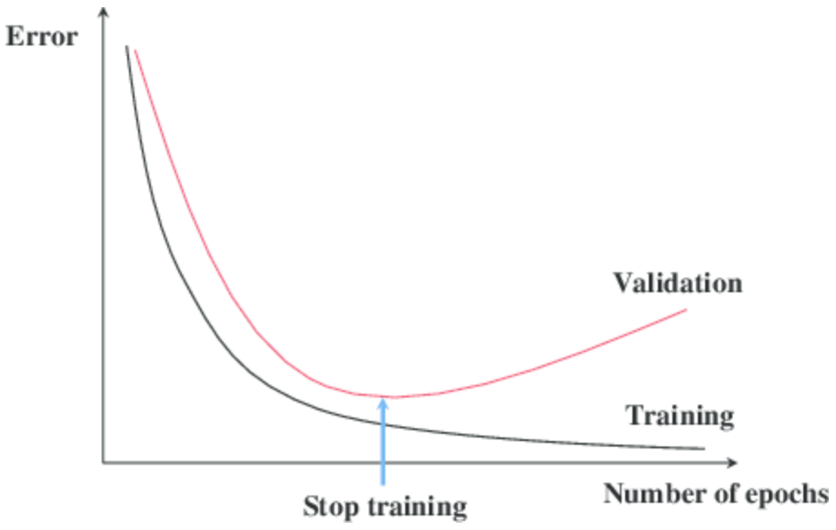
Early Stopping
Reduced number of epochs to 15 from 50
Proved immensely useful while using validation set
Validation set saturation

Slide 12
Best Model
Identified He as the best model for our problem statement
Model | Training | Validation | Test
He | 98.8 % | 98 % | 98.3 %

Slide 13
Conclusion
Used gradient descent optimization techniques to increase the speed and accuracy of model
Optimized ____ parameters in order to improve the performance
Incorporated early stopping to reduce the number of epochs to 15, from 50
He Model was able to classify the pear images with 98.8% accuracy

Slide 14

Thank you Peary much !!!

